Slide 2


Analysis of FPAs in the LHC RB circuit
Christoph Obermair, TE-MPE-CB Lukas Felsberger, TE-MPE-MI Franz Pernkopf, TU-Graz Andrea Apollonio, TE-MPE-CB Daniel Wollmann, TE-MPE-CB

Slide 3
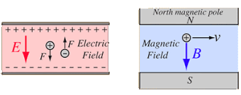
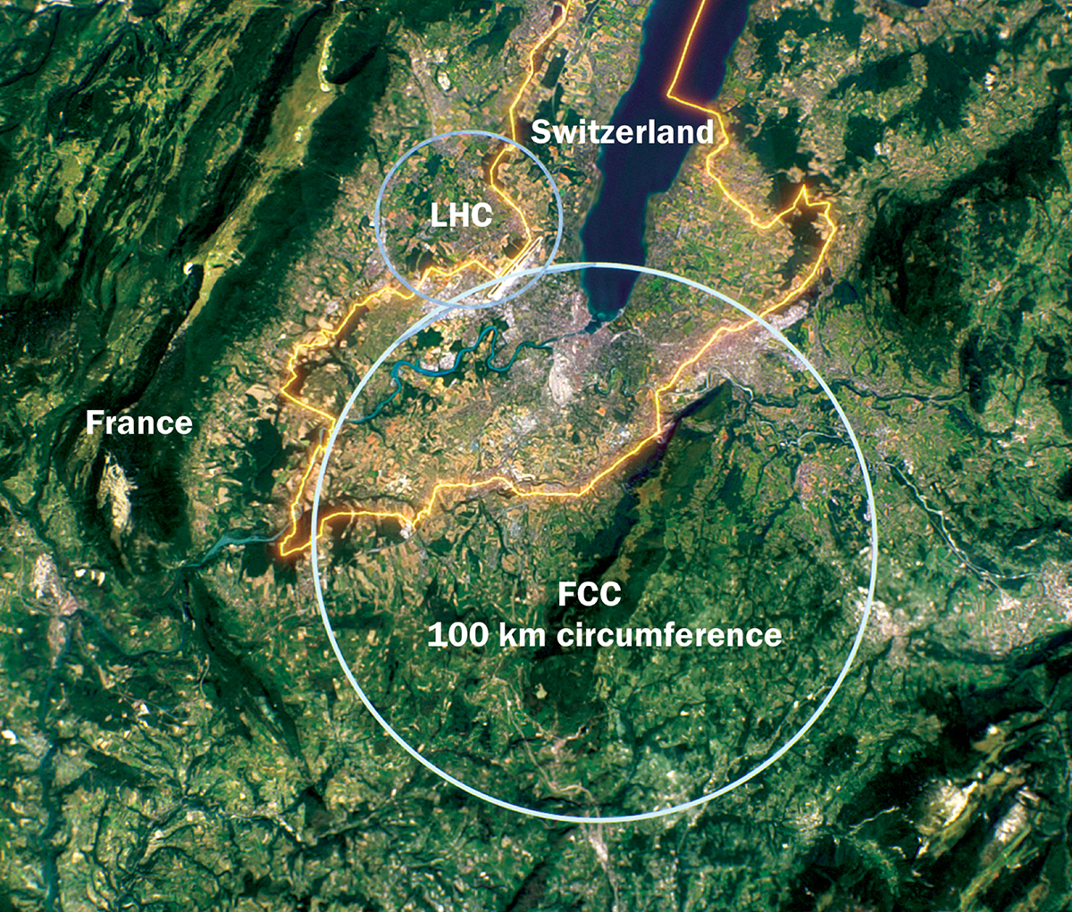
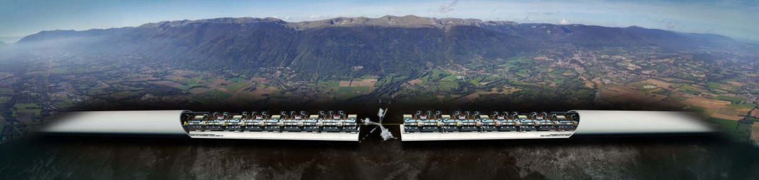
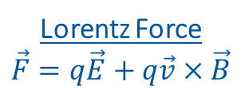
Introduction to Accelerators
Principle: Accelerate particles with electric field, and analyze collissions with target.
Types:
Linear accelerators - Linear accelerator 4 (Linac4)
Limitation to high collission energy is electric field
Breakdowns can destry radio frequency cavities
Circular accelerators - Large Hadron Collider (LHC)
Limitation to high collission energy is electric field
Quenches can destroy magnets
Current LHC status: LHC page 1
Lorentz Force
$$\vec{F}=q\vec{E}+q\vec{v}×\vec{B}$$
CLIC concept image

Slide 4
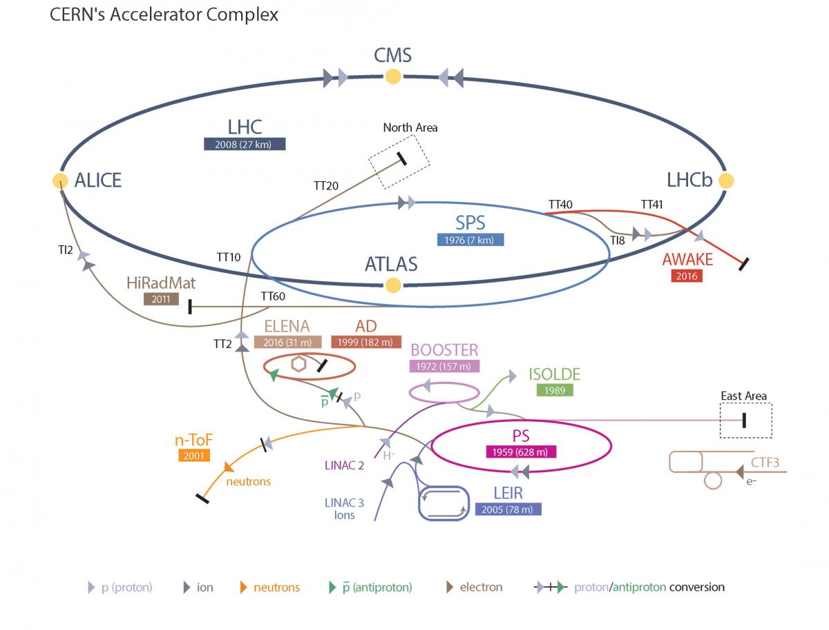
Large Hadron Collider - LHC
LHC Facts
Cost of the LHC | 4332 MCHF
Length | 26 659 m
Dipole operating temperature | -271.3°C
Cost per magnet | ~ 1 MCHF
Number of main dipoles | 1232
Power consumtion | 1.3 TWh/a
Number of circuits | 8
Stored energy per circuit | 1.1 GJ (380-ton TGV @ 50km/h)
11/7/2022

Slide 5
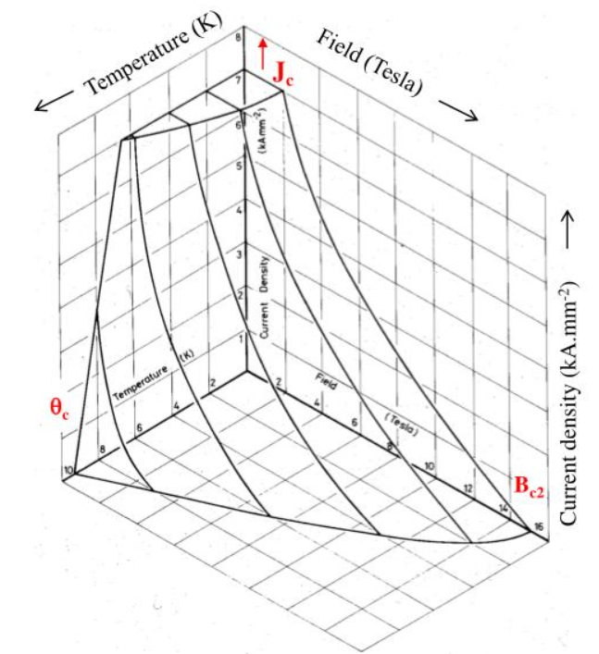
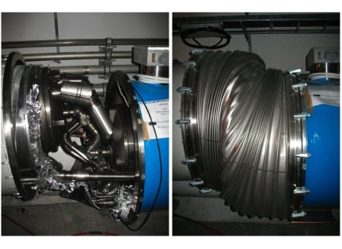
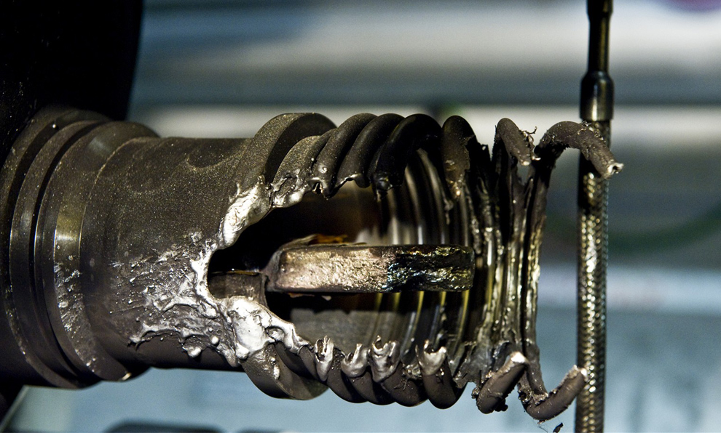
Quench Protection
Quench is biggest threat to LHC dipole magnets
Different types of quench:
Primary quench
Secondary quench: GHe propagation, EM disturbance,..
Quench Protection:
Bypass Diode
Quench Heater
Quenches with destructed magnets:
2008 (~100 destroyed magnets – splice opened)
2021 HWC (1 destroyed magnet - interturn short in coil)
Possible precursor detected 1 month before
Precursor: Oscillation in U_Diode Voltage
Goal: Further precursors?
Critical surface NbTi

Slide 6
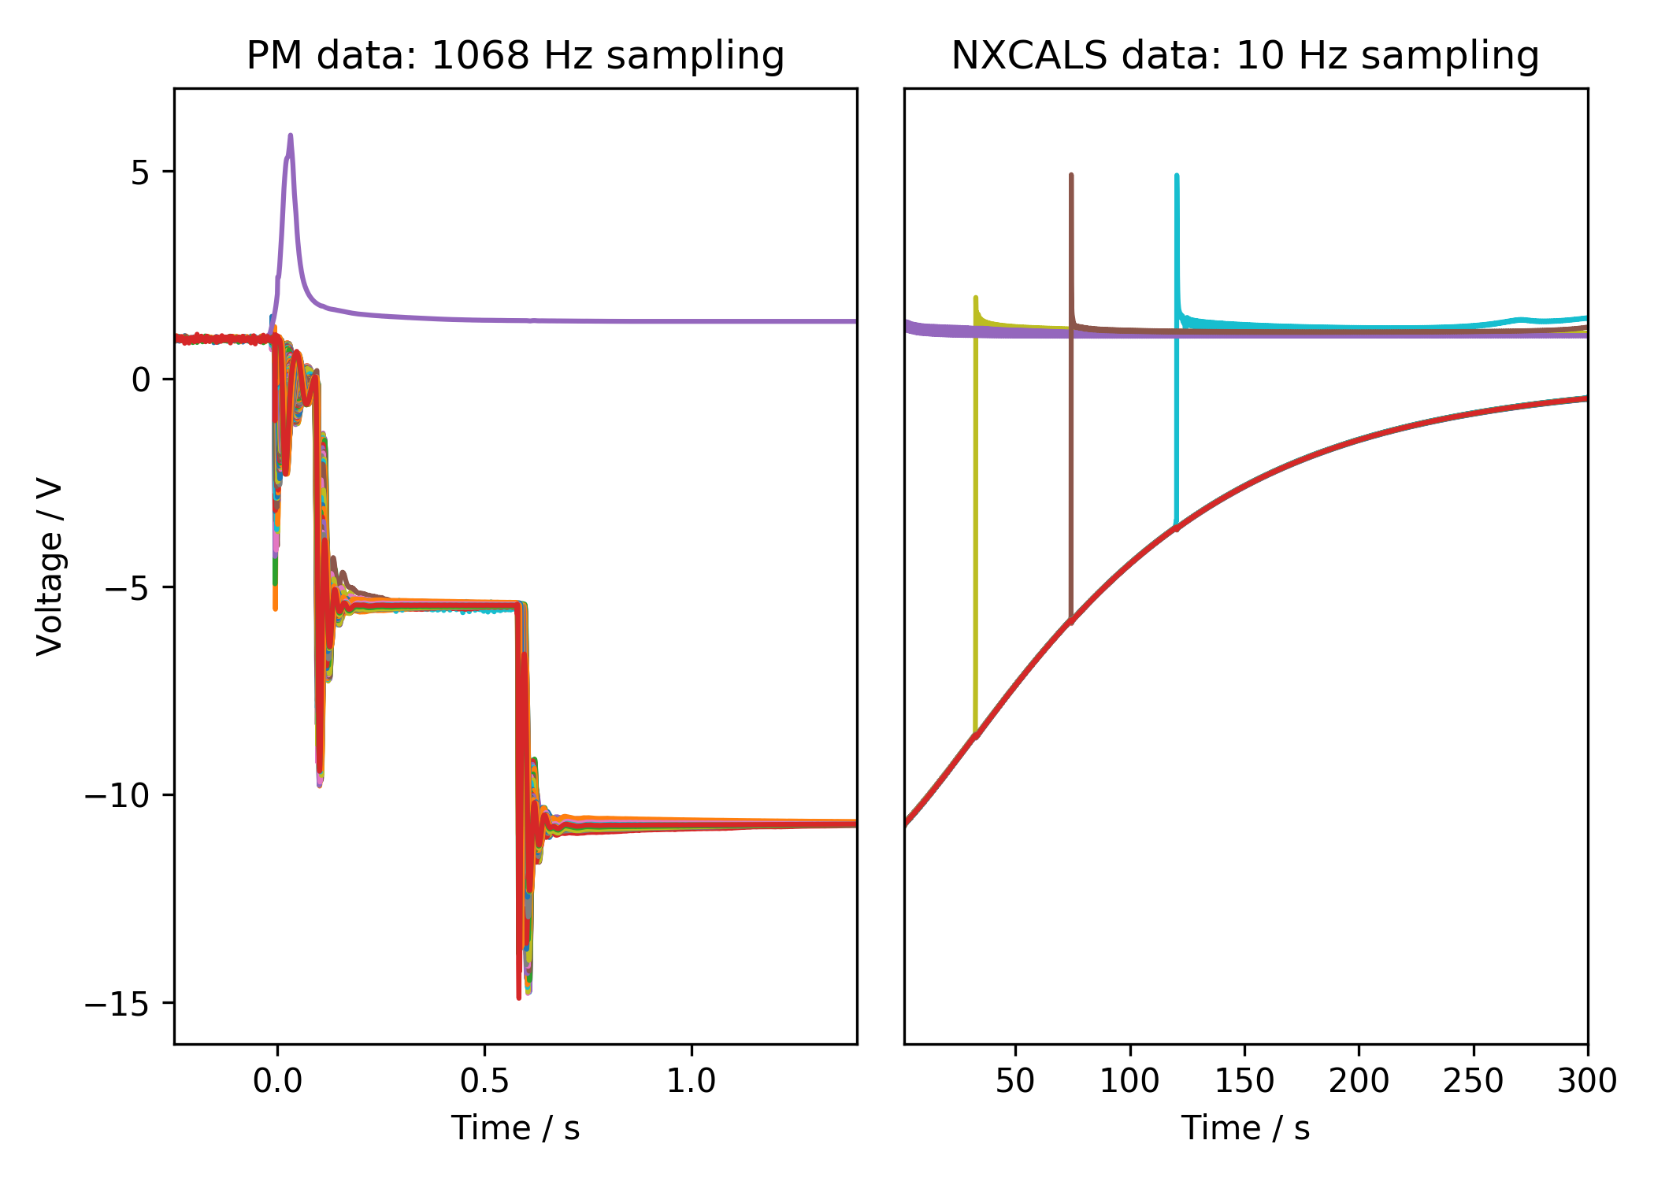
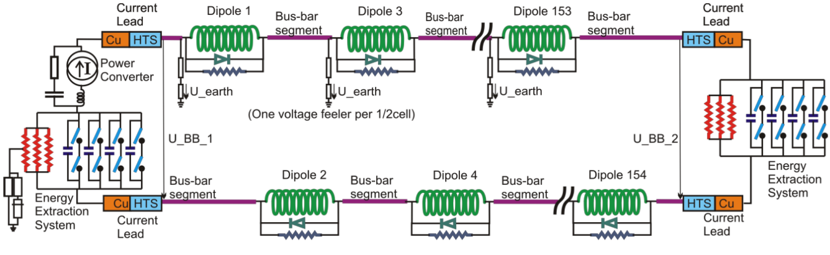
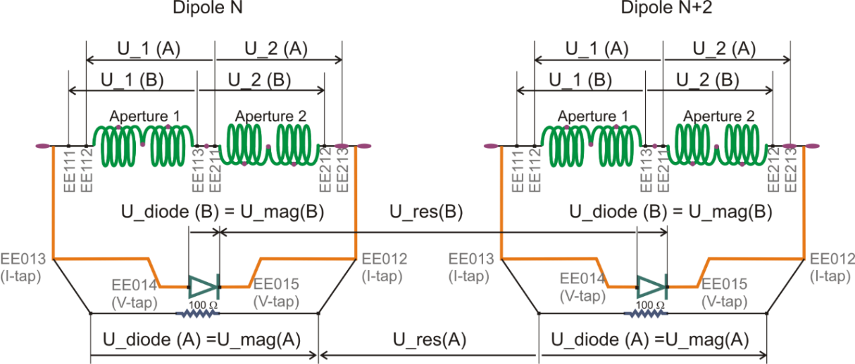
Quench Protection: U-Diode
Interesting area
2nd EE switch off
Secondary quench
1st EE switch off
PC Switch off

Slide 7
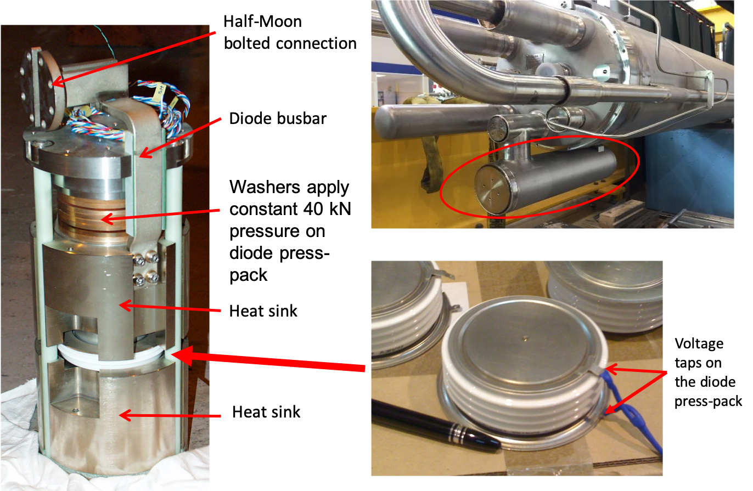
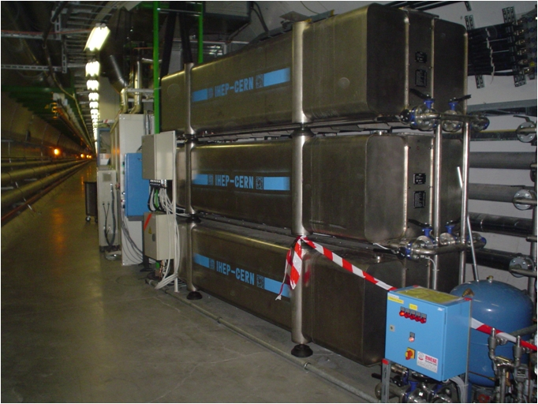
Hardware
Diode
Energy Extraction Resistance

Slide 8
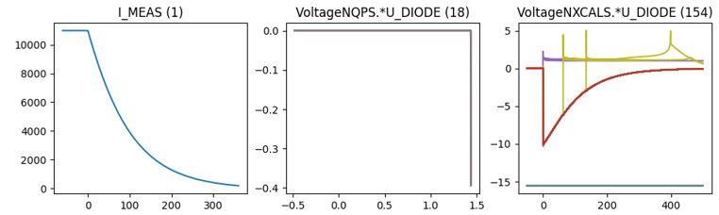
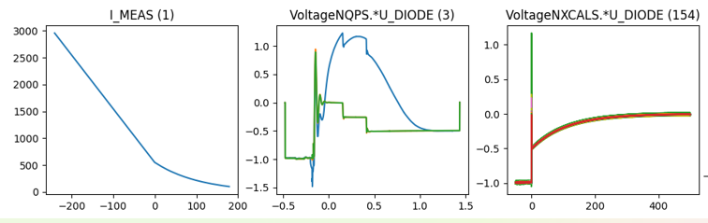
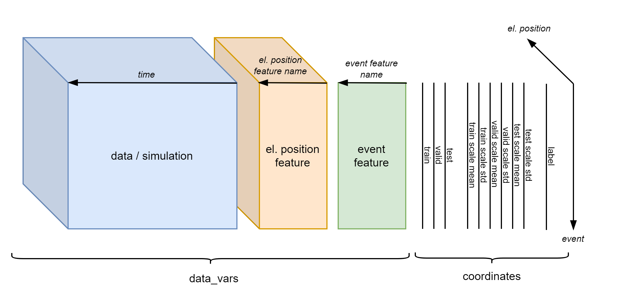
Existing Database Overview
Data overview
Filtered events
 | Signal | 2014-2020 | 2021 | # events
Real Data | U_DIODE_NXCALS | P | P | 867
 | U_DIODE_PM | P | P | 629
 | I_MEAS | P | P | 896
 | U_QSO, U_1, U_2 | P | P | 893
 | I_EARTH_PCNT | P | P | 895
 | I_EARTH | P | P | 629
 | I_HDS, U_HDS | P | P | 896
 | EEUDumpResPM | P | P | 896
Simulations | V(0v_magf*) | P | P | 875
 | I(r1_warm) | P | P | 875
 | V(10,11), V(18,19) | P | P | 875
#events |  | 267 | 629 | 560/896

Slide 9
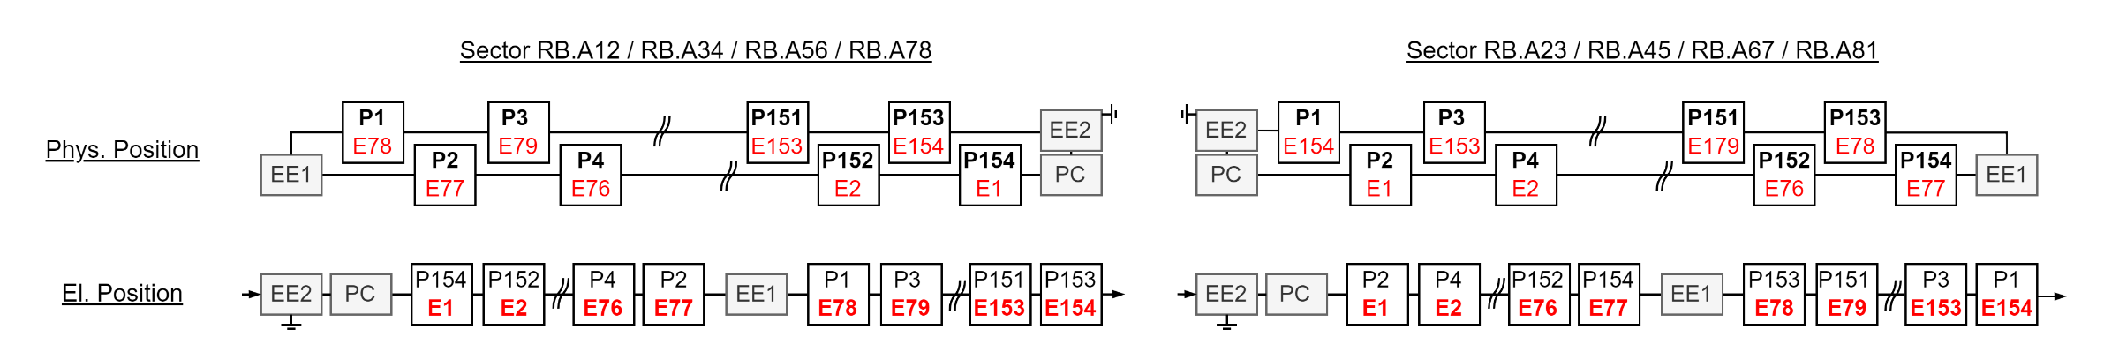
El. Vs Phys. Position

Slide 10
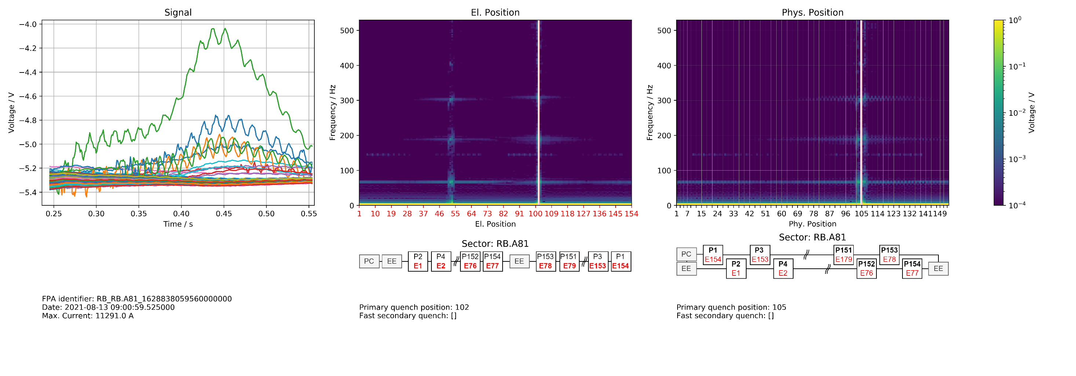
Position Frequency Map

Slide 11
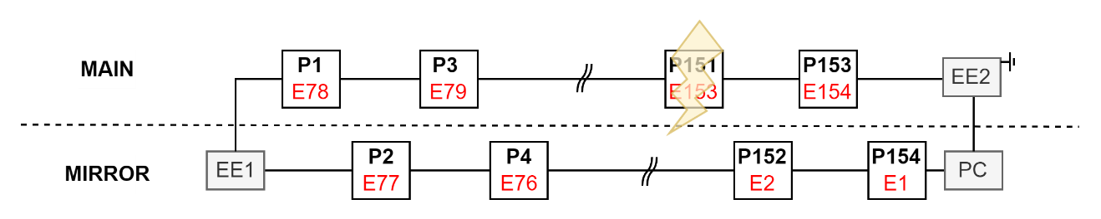
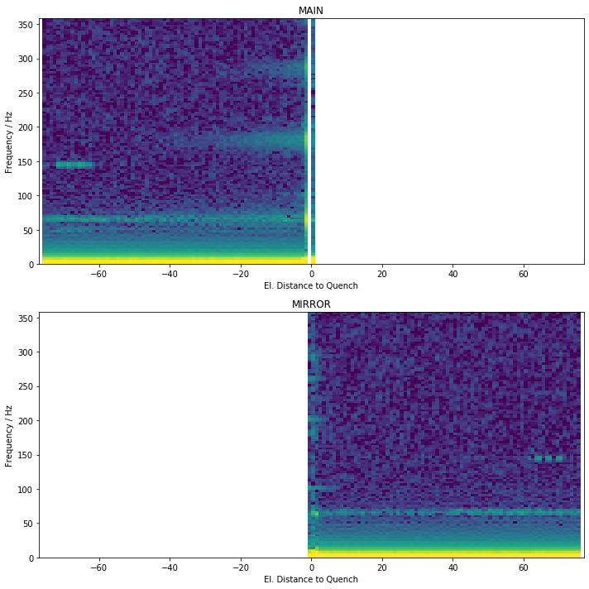
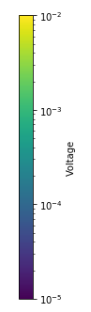
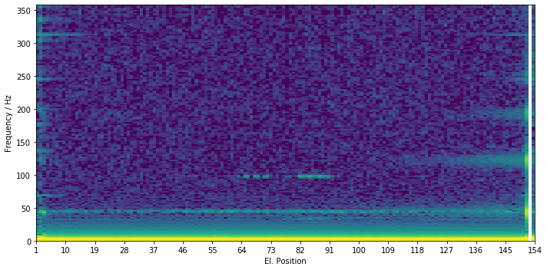
Generalization
To calculate statistics, quench must occur at same position
Not consider events with secondary quenches
Split into
MAIN: Half where quench occurred
MIRROR: Other Half

Slide 12
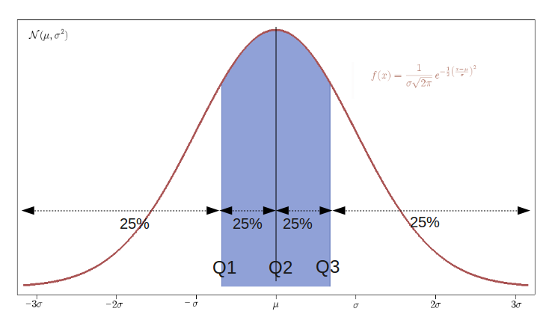
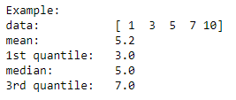
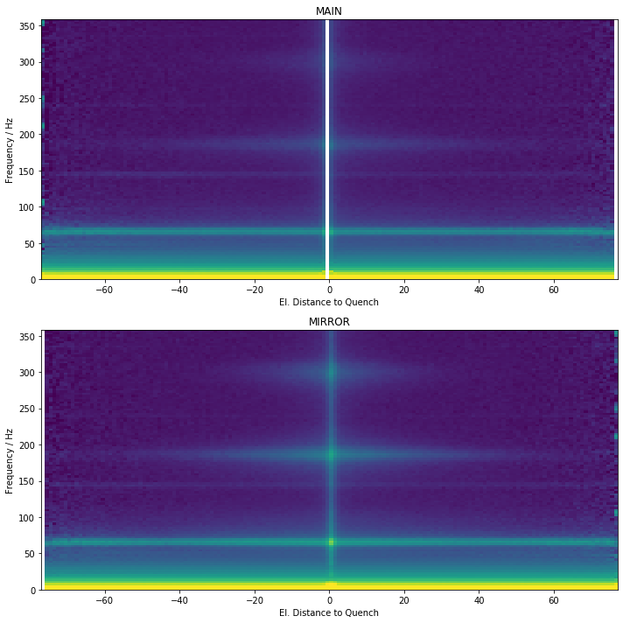
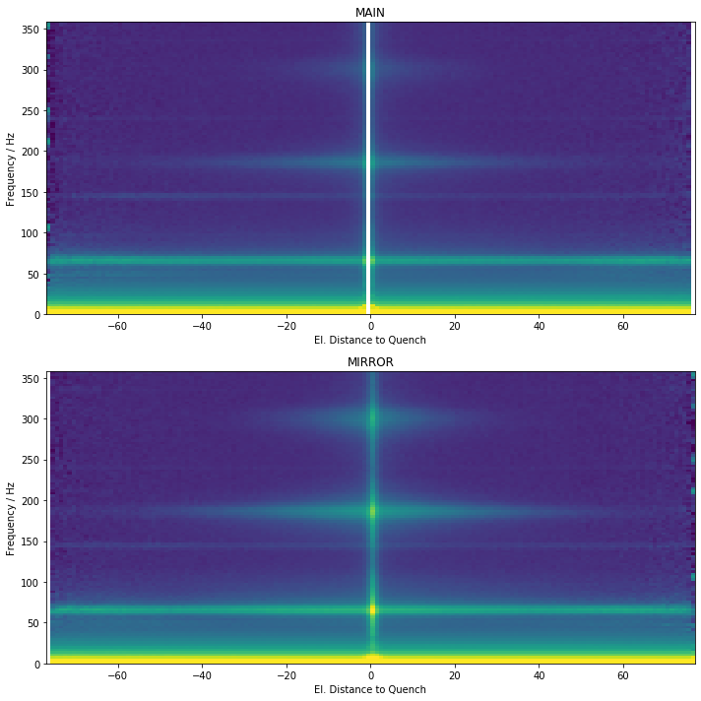
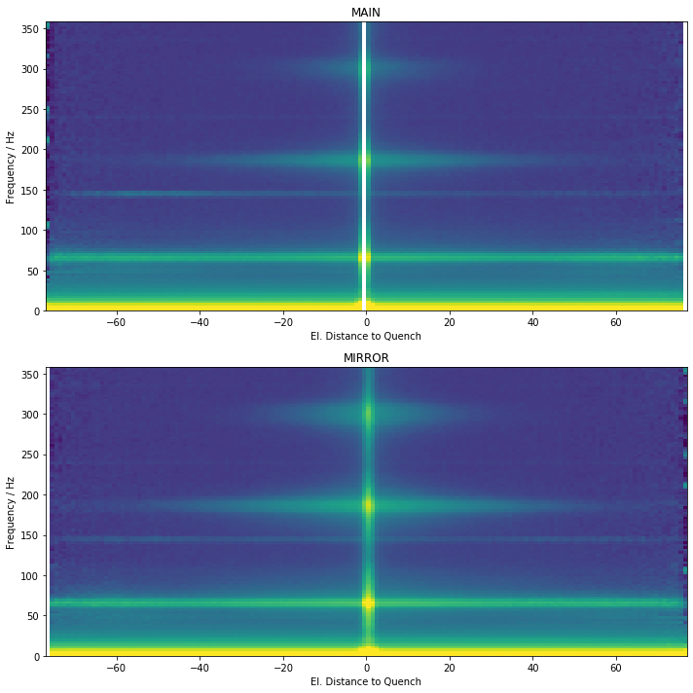
Quantiles
1st quantile
median
3rd quantile

Slide 13
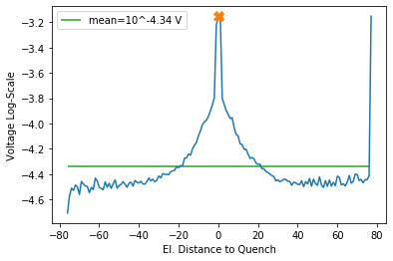
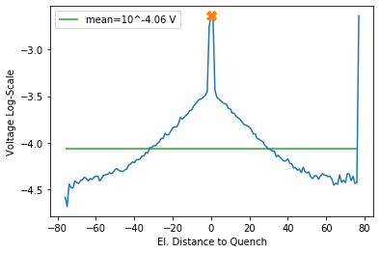
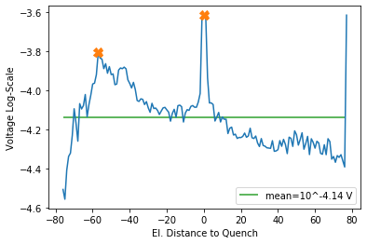
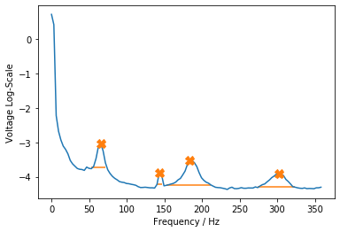
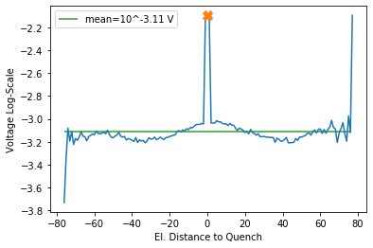
Find Peaks 3rd Quantil
302.1 Hz
183.8 Hz
143.3 Hz
65.4 Hz

Slide 14
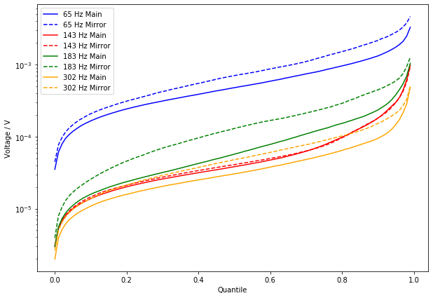




Voltage = f(Quantile)
302.1 Hz
1st Plateau
$${10}^{−3.11} V$$
183.8 Hz
$${10}^{−4.06} V$$
$${10}^{−4.14} V$$
$${10}^{−4.34} V$$
143.3 Hz
3rd Quantil (0.75)
65.4 Hz

Slide 15
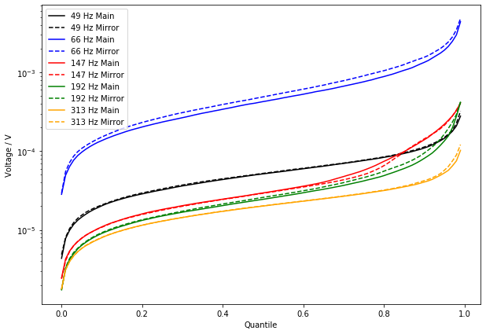
Voltage = f(Quantile)
1st Plateau
2nd Plateau

Slide 16
Non-Negative Matrix Factorization

Slide 17
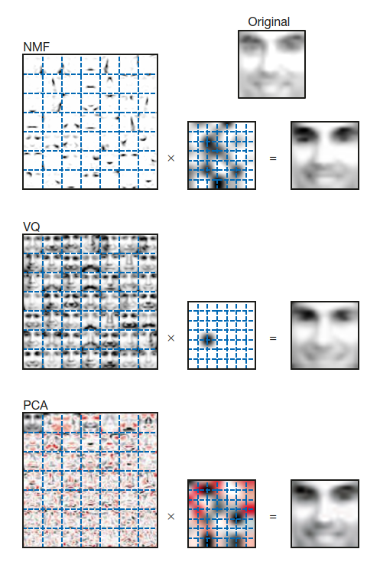

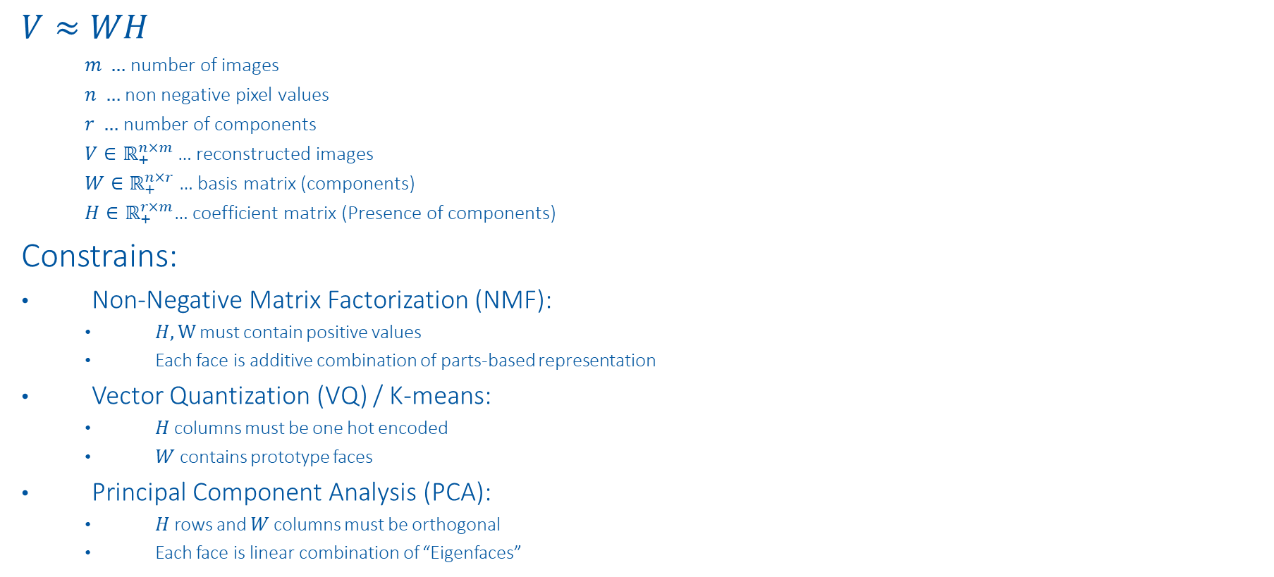

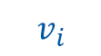
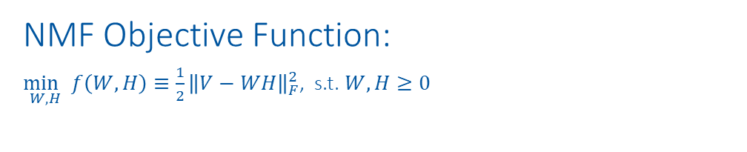
NMF vs. VQ vs. PCA
$$W$$
$$h_{i}$$
$$V≈WH$$
$m …$ number of images
$n …$ non negative pixel values
$r …$ number of components
$V∈ℝ_{+}^{n×m}$… reconstructed images
$W∈ℝ_{+}^{n×r}$… basis matrix (components)
$H∈ℝ_{+}^{r×m}$… coefficient matrix (Presence of components)
Constrains:
Non-Negative Matrix Factorization (NMF):
$H,W$ must contain positive values
Each face is additive combination of parts-based representation
Vector Quantization (VQ) / K-means:
$H$ columns must be one hot encoded
$W$ contains prototype faces
Principal Component Analysis (PCA):
$H$ rows and $W$ columns must be orthogonal
Each face is linear combination of “Eigenfaces”
NMF Objective Function:
$\underset{W,H}{\min{ }}f\left(W, H\right)≡\frac{1}{2}{\left\|V−WH\right\|}_{F}^{2}$, s.t. $W, H≥0$
$$v_{i}$$
https://www.nature.com/articles/44565
https://proceedings.neurips.cc/paper/2000/file/f9d1152547c0bde01830b7e8bd60024c-Paper.pdf

Slide 18
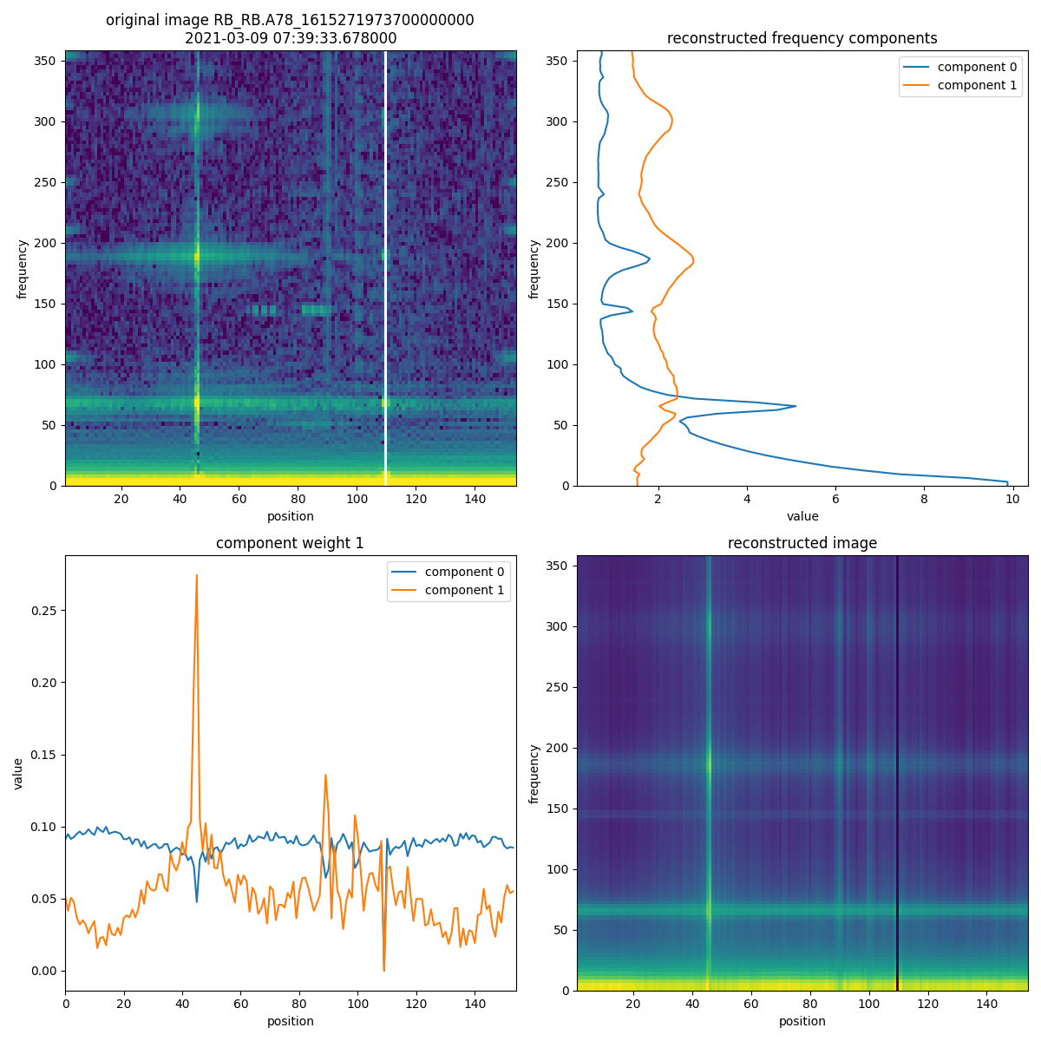
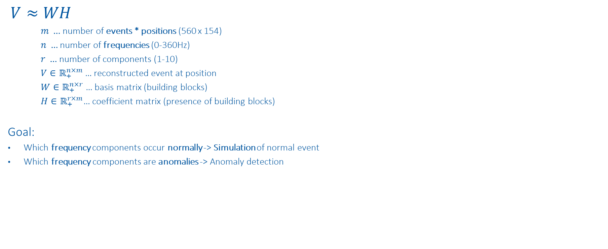
NMF on Position Frequency Maps
$$V≈WH$$
$m …$ number of events * positions (560 x 154)
$n …$ number of frequencies (0-360Hz)
$r …$ number of components (1-10)
$V∈ℝ_{+}^{n×m}$… reconstructed event at position
$W∈ℝ_{+}^{n×r}$… basis matrix (building blocks)
$H∈ℝ_{+}^{r×m}$… coefficient matrix (presence of building blocks)
Goal:
Which frequency components occur normally -> Simulation of normal event
Which frequency components are anomalies -> Anomaly detection
https://www.nature.com/articles/44565
https://proceedings.neurips.cc/paper/2000/file/f9d1152547c0bde01830b7e8bd60024c-Paper.pdf

Slide 19
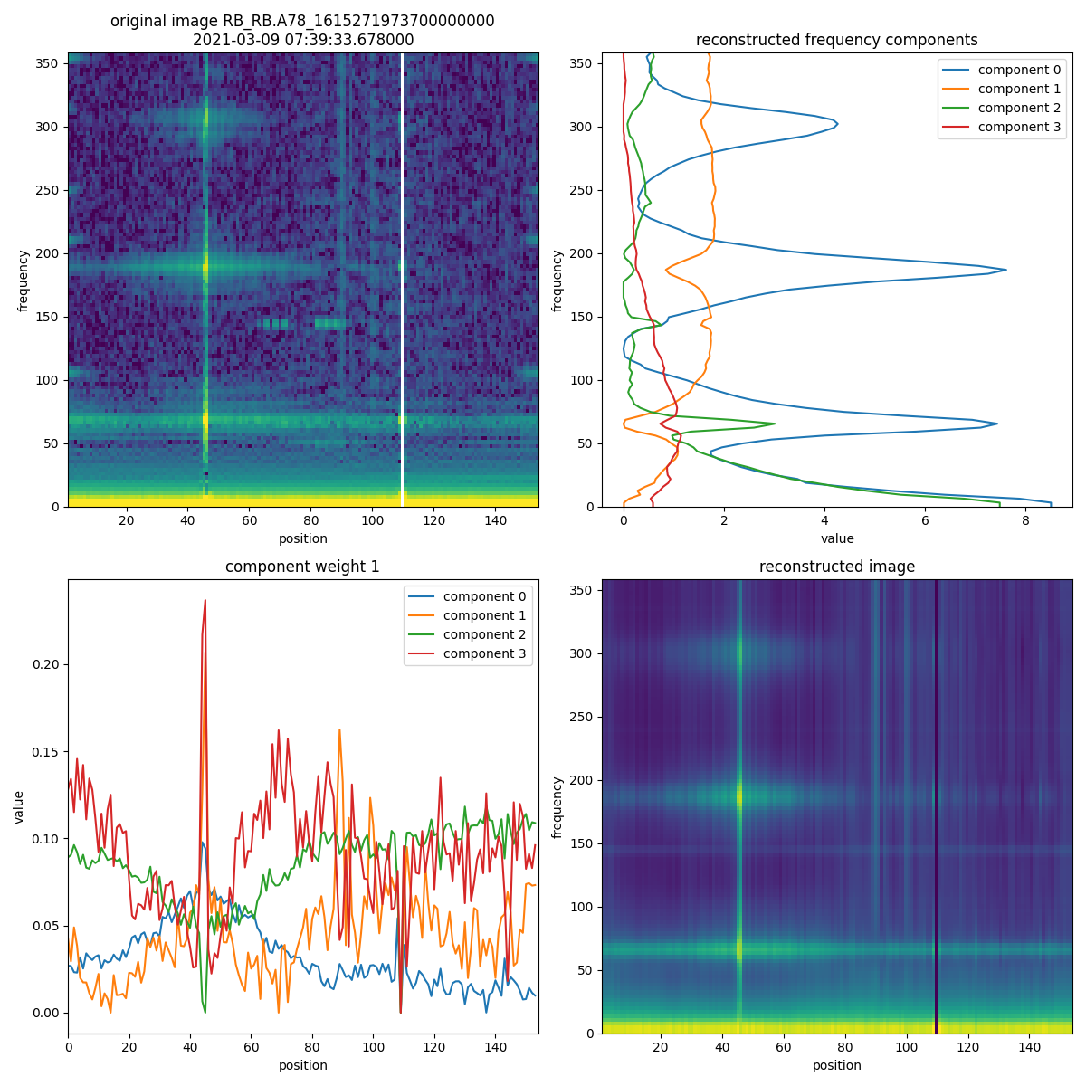
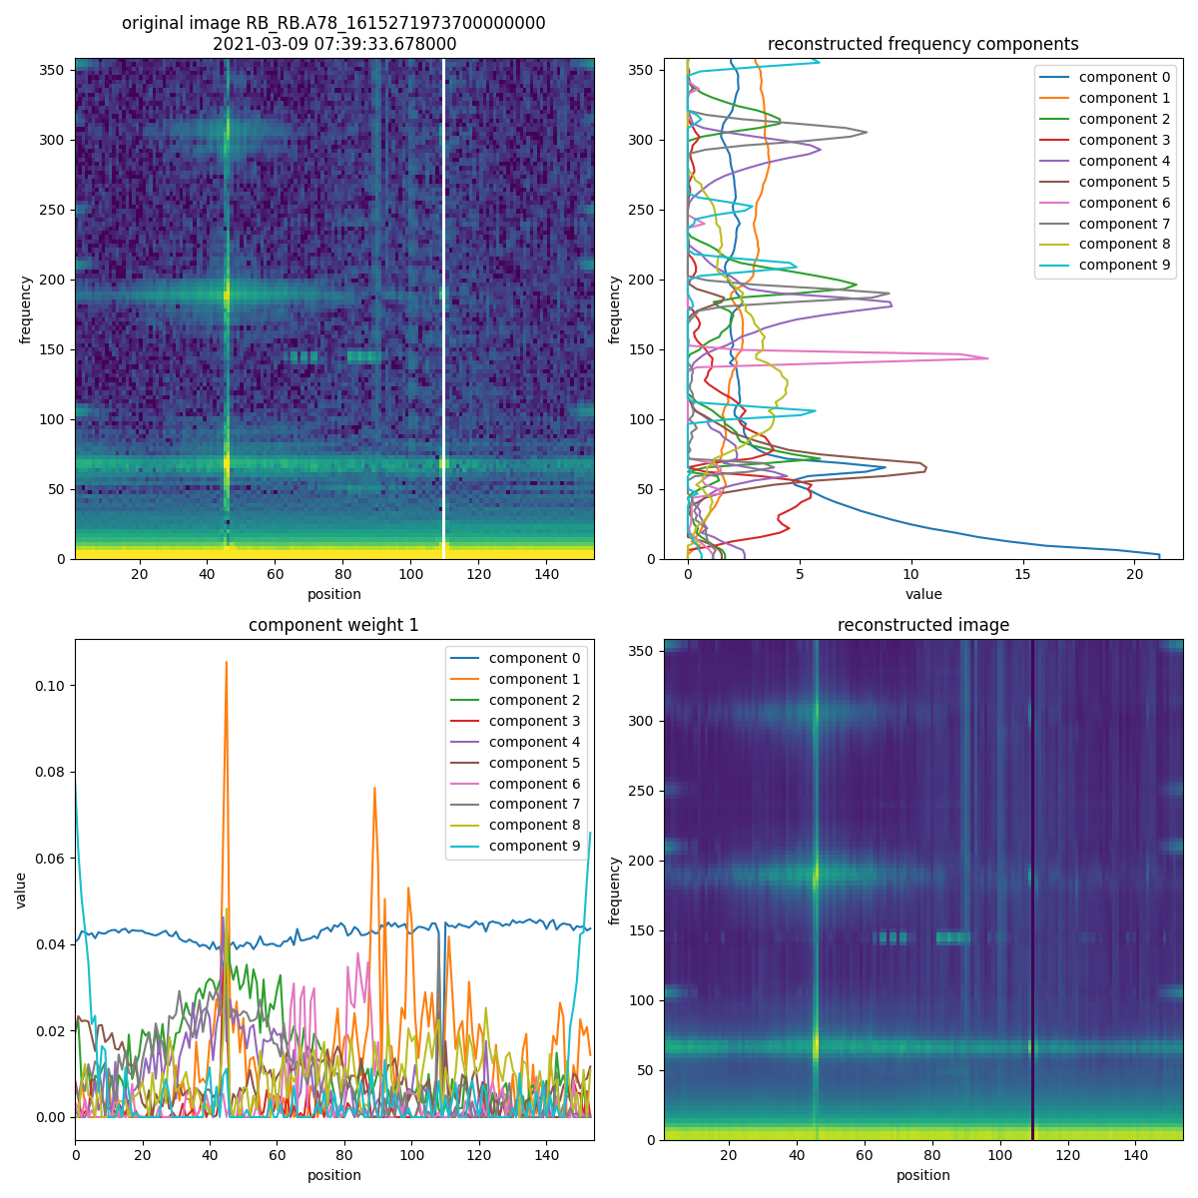
NMF on Position Frequency Maps

Slide 20
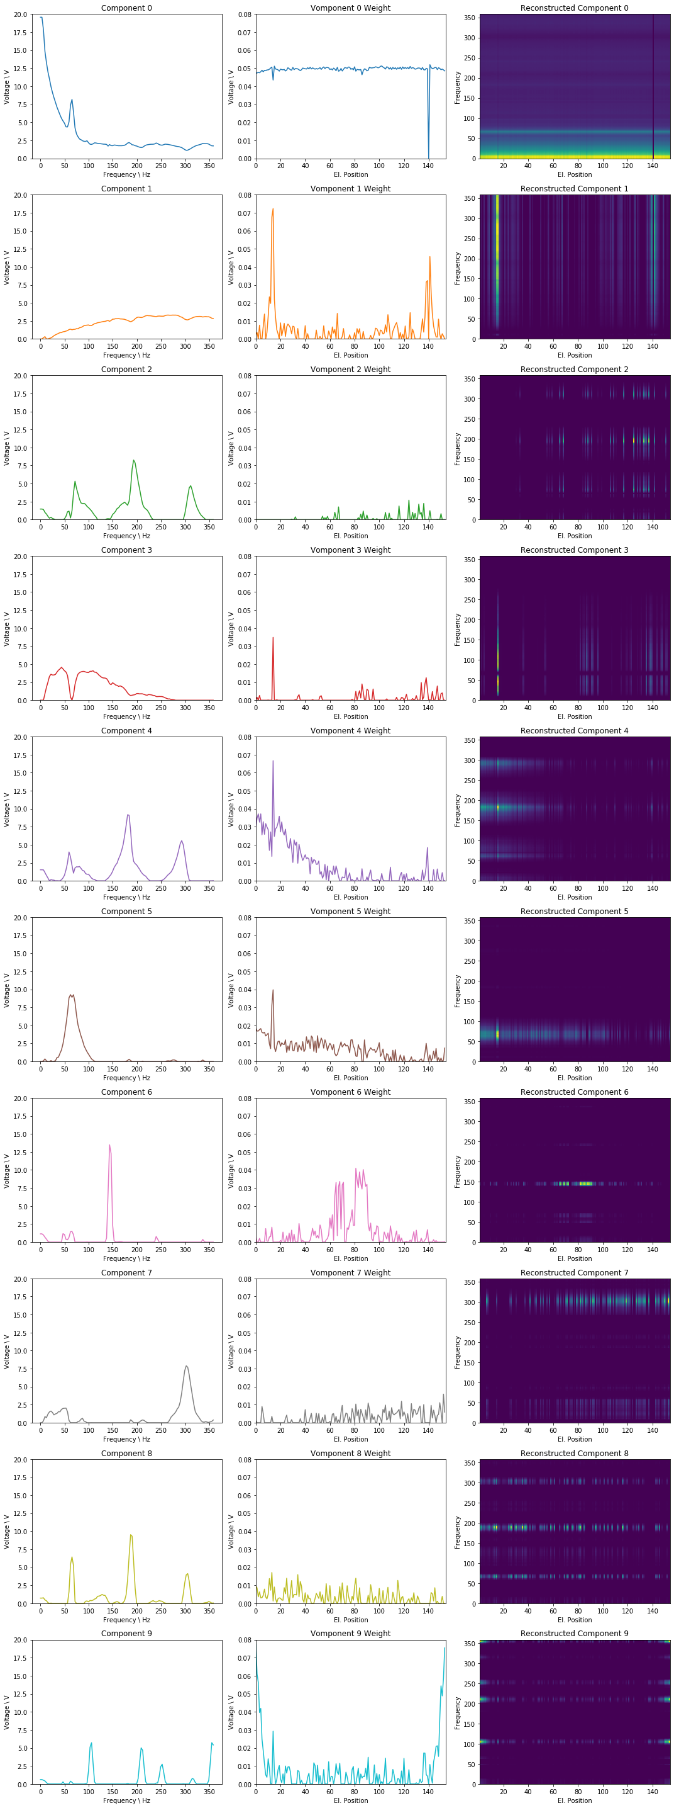
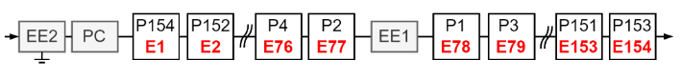
NMF on Position Frequency Maps
Parameter: n_components=10,
init='nndsvd', tol=1e-3, l1_ratio=0.5, regularization='both', alpha=1

Slide 21
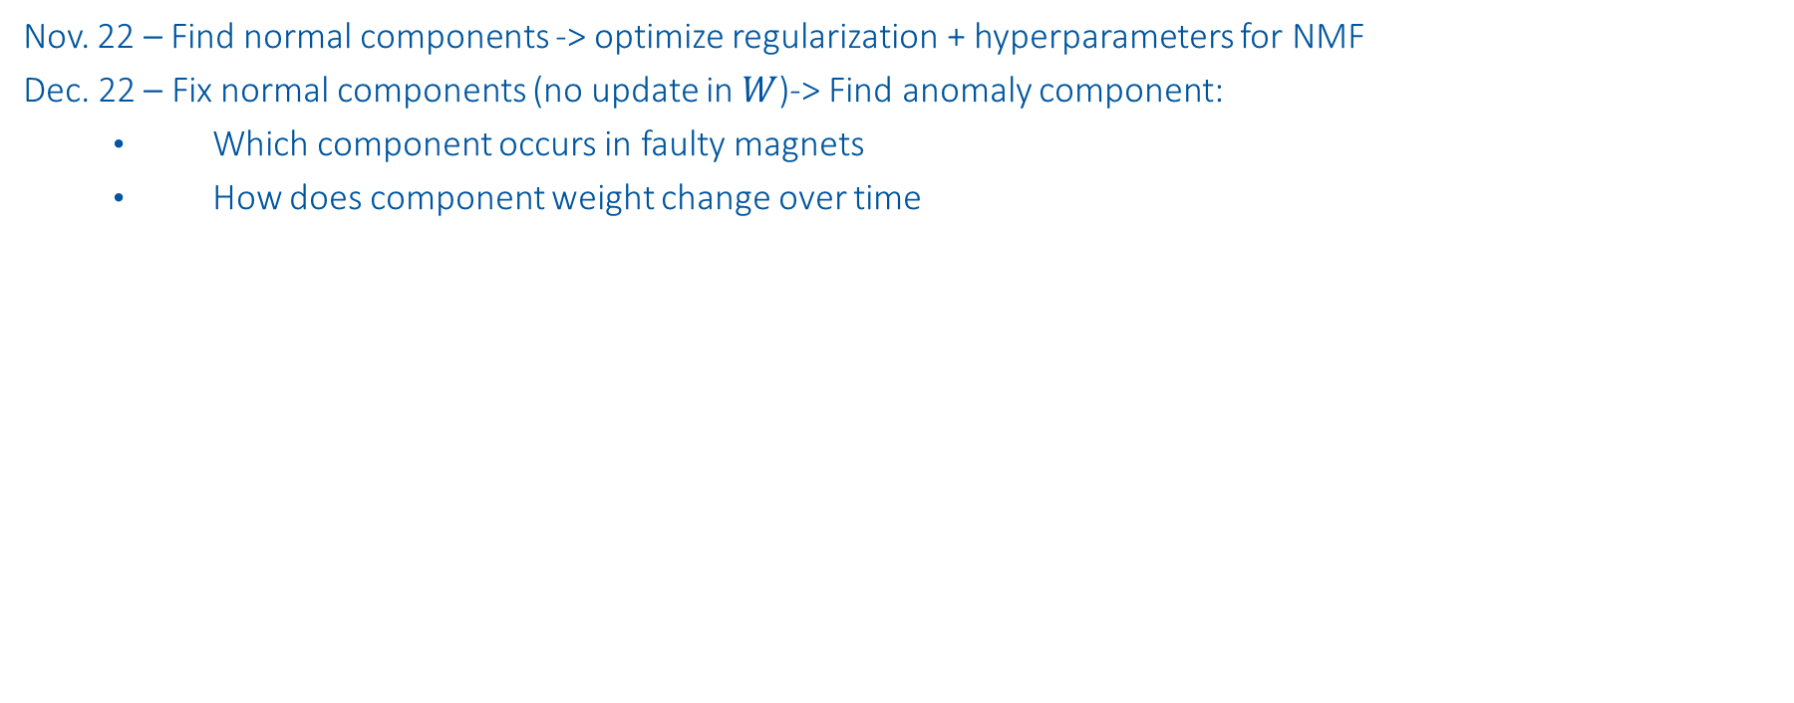
Next Steps
Nov. 22 – Find normal components -> optimize regularization + hyperparameters for NMF
Dec. 22 – Fix normal components (no update in $W$)-> Find anomaly component:
Which component occurs in faulty magnets
How does component weight change over time

Slide 22
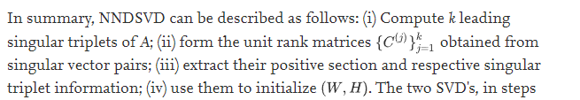
NMF sensitivity analysis
Values to vary:
Initialization:
'nndsvd': Nonnegative Double Singular Value Decomposition (NNDSVD)
'nndsvda': NNDSVD with zeros filled with the average of X
Regularization:
None, L1, L1+L2, L2
On Transformation (H), and Components + Transformation (W + H)
Weight
Orthogonal Loss
Shuffle: True, False
*SVD based initialization: A head start for nonnegative matrix factorization

Slide 23
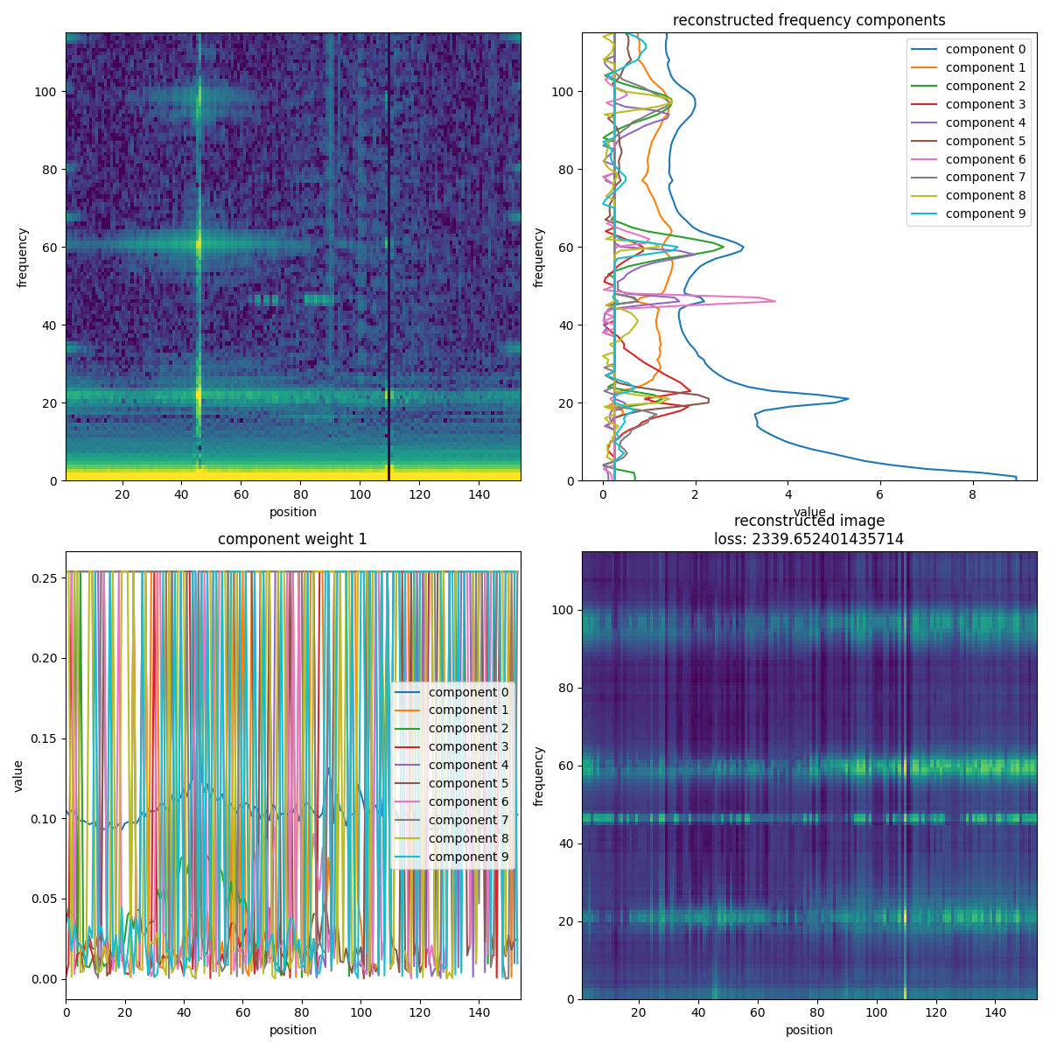
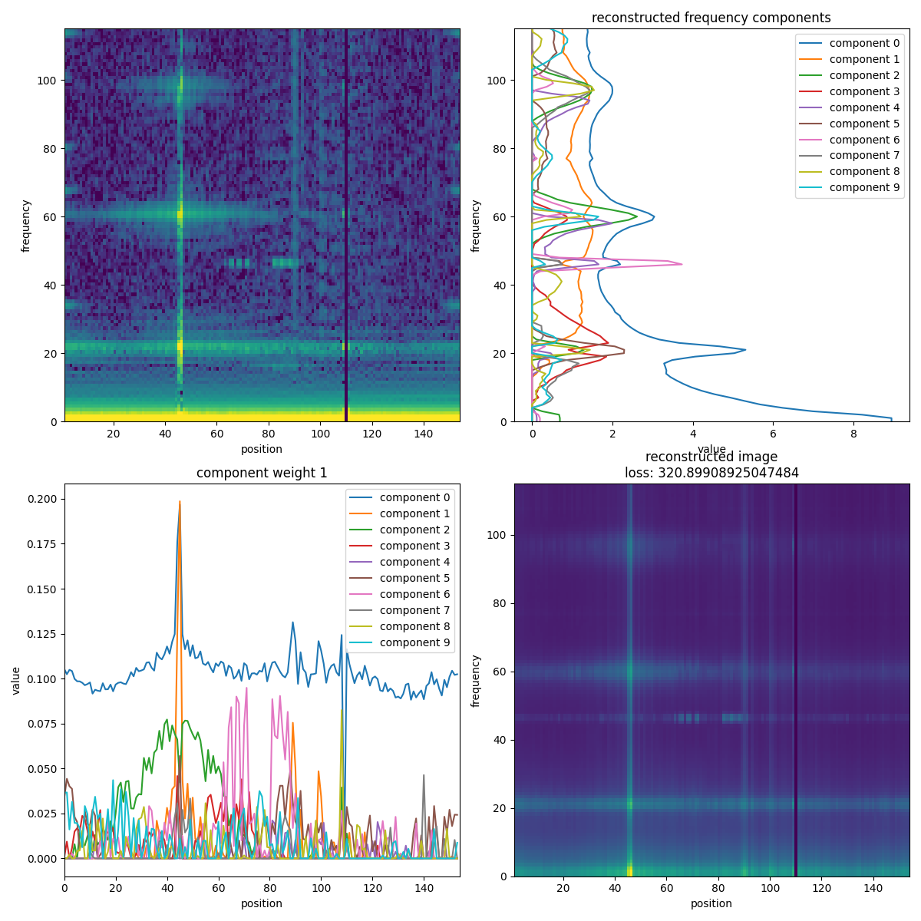
'nndsvd vs 'nndsvda'
Assumption: L1 & L2 regularization
nndsvd Initialization
nndsvda Initialization

Slide 24
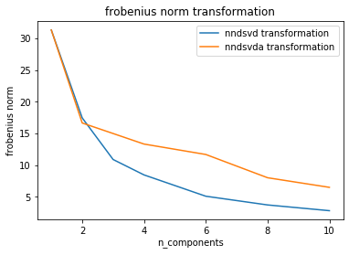
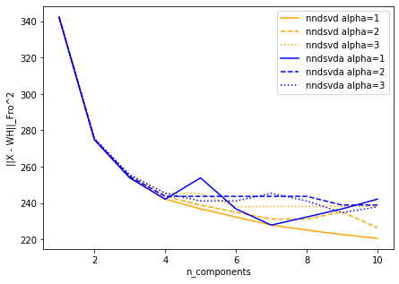



'nndsvd vs 'nndsvda'
Assumption: L1 & L2 regularization

Slide 25


'nndsvd vs 'nndsvda'
Assumption: L1 & L2 regularization (weight =1), 8 components
Conclusion: nndsvd slightly better, nndsvda is much faster
nndsvd
nndsvda

Slide 26


'nndsvd vs 'nndsvda'
Assumption: L1 & L2 regularization (weight =3), 8 components
Conclusion: nndsvd slightly better, nndsvda is faster (due to stopping criterion)
nndsvd
nndsvda

Slide 27





Regularization: None, L1, L1+L2, L2
Assumption: nndsvda, On Components + Transformation (W + H)

Slide 28


Regularization: None, L1, L1+L2, L2
Conclusion: L1+L2 lead to best result
None
L1+L2

Slide 29


Regularization: None, L1, L1+L2, L2
Conclusion: L1+L2 lead to best result
L1
L2

Slide 30


Regularization: “both”, “transformation”
Assumption: nndsvda
Conclusion: H values get smaller and smaller, does not converge
None
L1+L2 on H

Slide 31





Weight & Shuffling
Assumption: nndsvda, On Components + Transformation (W + H), L1 + L2, 6 components
Conclusion: shuffling reduces variance of results
Alpha: weight of regularization

Slide 32


Weight & Shuffling
Assumption: nndsvda, On Components + Transformation (W + H), L1 + L2, 6 components
Conclusion: shuffling reduces variance of results
Alpha: weight of regularization
alpha = 0
alpha = 4

Slide 33





Weight & Shuffling
Assumption: nndsvda, On Components + Transformation (W + H), L1 + L2, 10 components
Conclusion: shuffling reduces variance of results
Alpha: weight of regularization

Slide 34


Weight & Shuffling
Assumption: nndsvda, On Components + Transformation (W + H), L1 + L2, 10 components
Conclusion: shuffling reduces variance of results
Alpha: weight of regularization
alpha = 0
alpha = 2.5

Slide 35




Orthogonal Loss

Slide 36

Orthogonal Loss
Assumption:
nndsvda
Reg. on Components + Transformation (W + H)
L1 + L2+ortho
8components

